Slide 1

NFT marketplace platform development on Elrond blockchain
Vladimir Andrianov
IABM34_Virumaa
16.12.2021

Slide 2
Structure
Abstract
Introduction
Problem (inefficient blockchain platforms on market)
Blockchain generations
Elrond specifics (latest, third generation)
Solution: NFT Marketplace on Elrond for community
Background
Borderless NFT art, marketplaces, existing solutions
Work methodology and methodology
Team, Git, Github, Team communication
Solution: frontend, backend, infrastructure, CMS
Business model
Analysis: Transactions, efficiency, costs
Summary
Acknowledgements

Slide 3
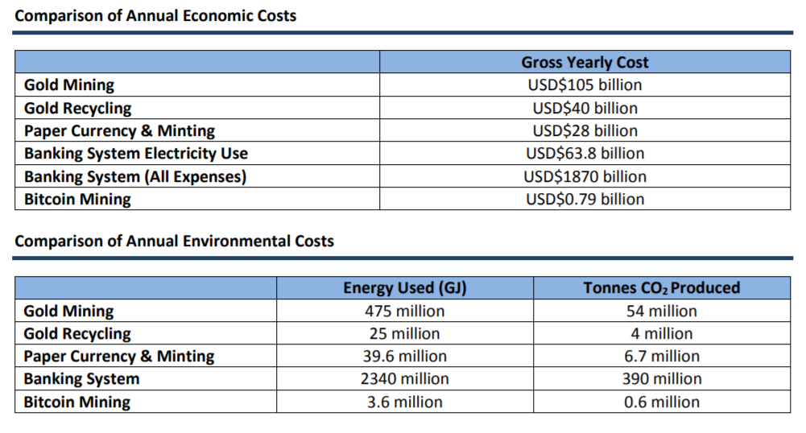
Blockchain efficiency

Slide 4
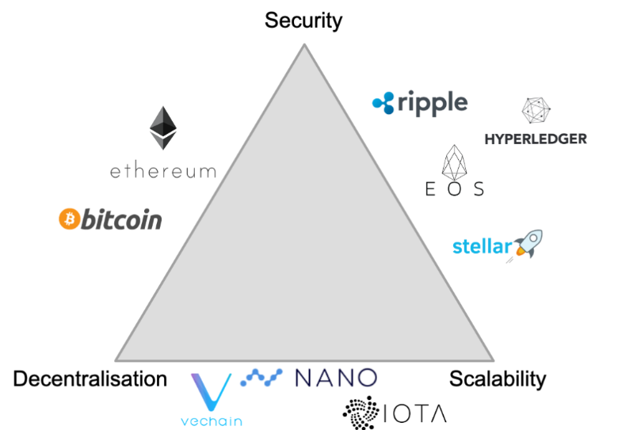
Blockchain trilemma

Slide 5
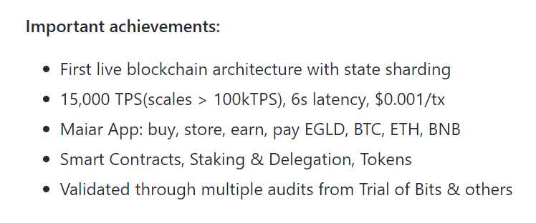
Elrond

Slide 6
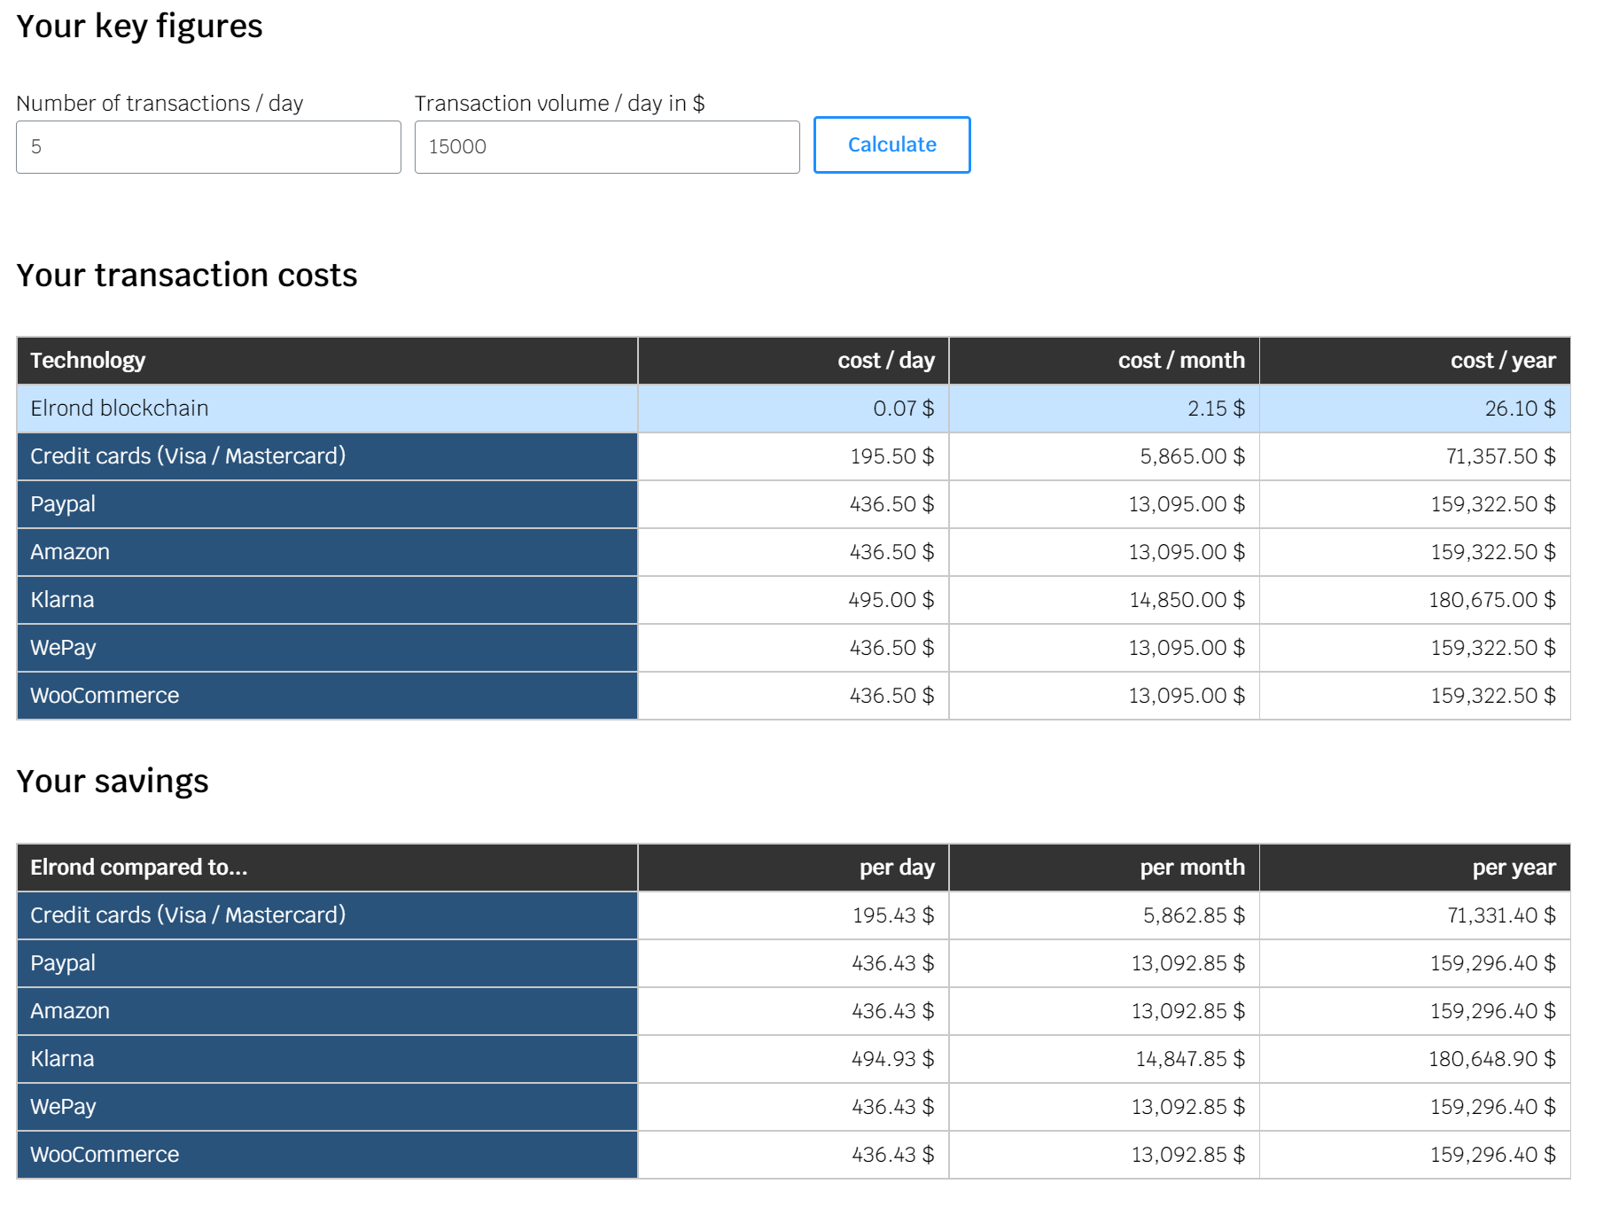
Fees

Slide 7
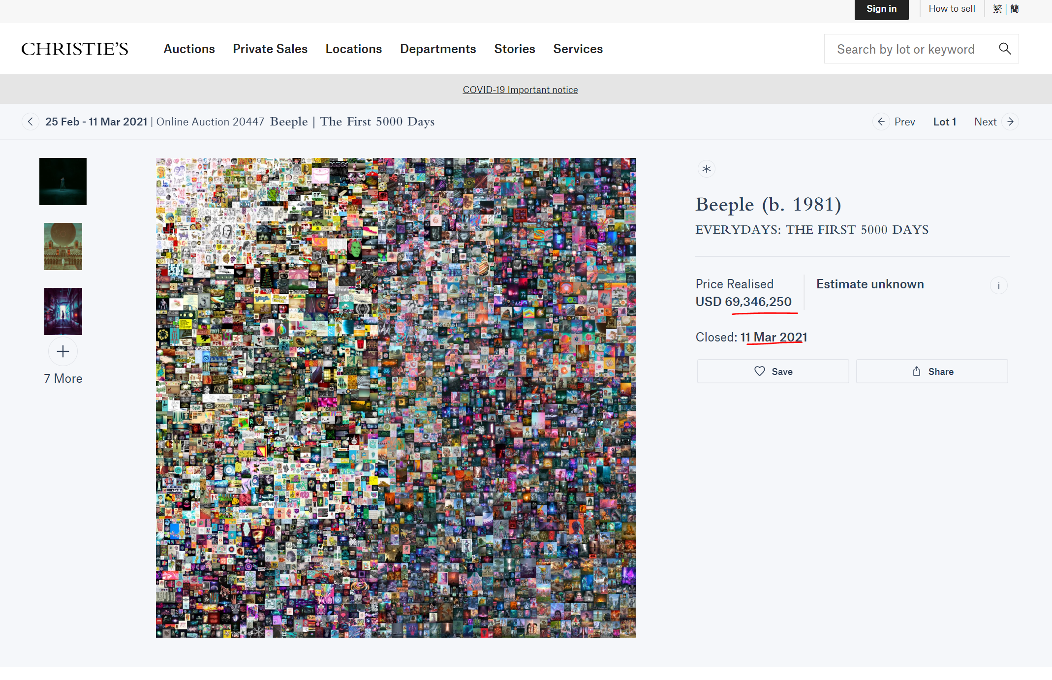
Value

Slide 8
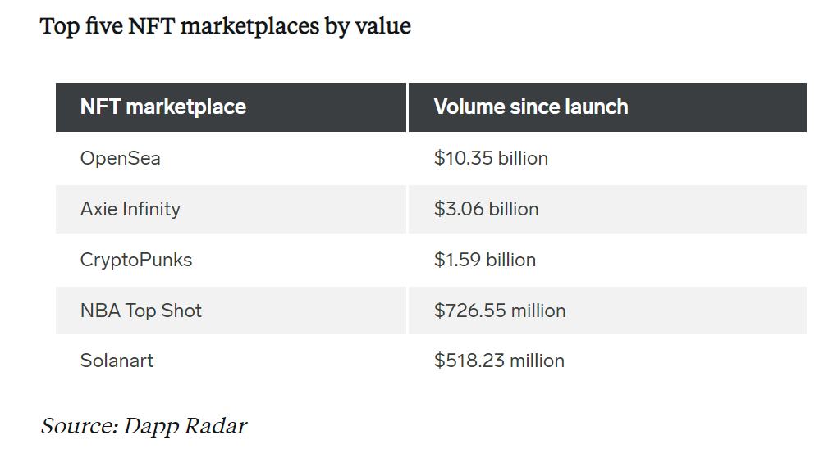
Market

Slide 9
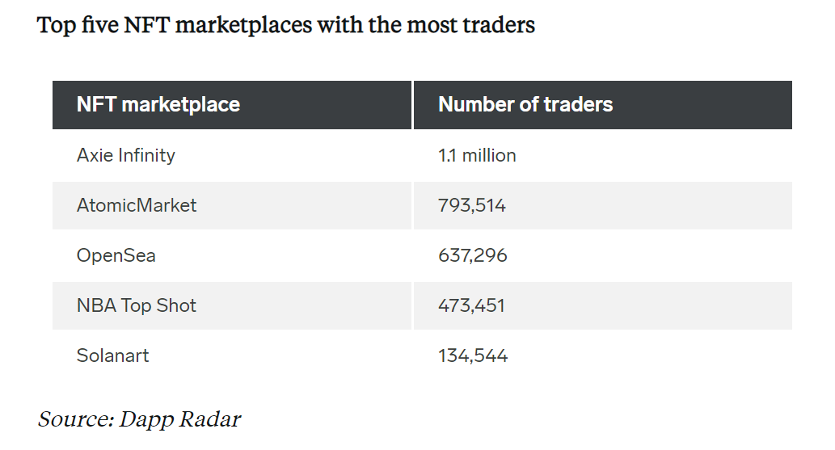
market

Slide 10
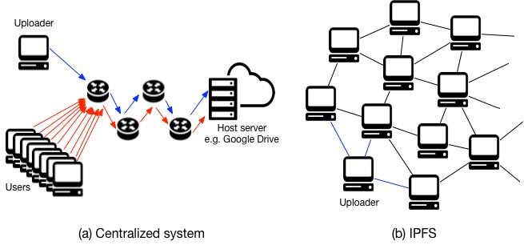
IPFS

Slide 11
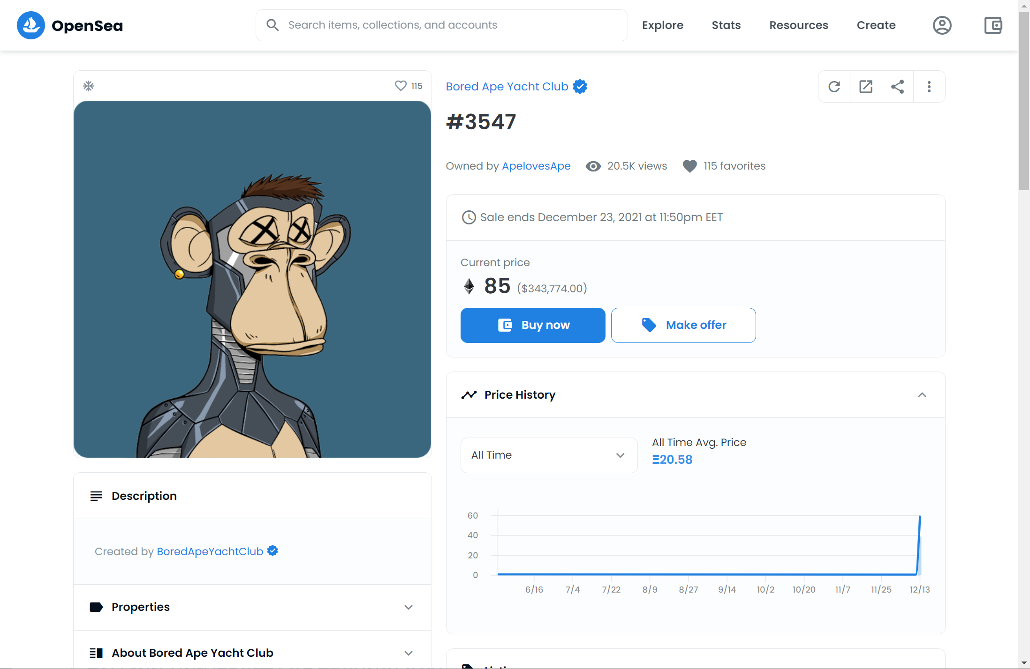
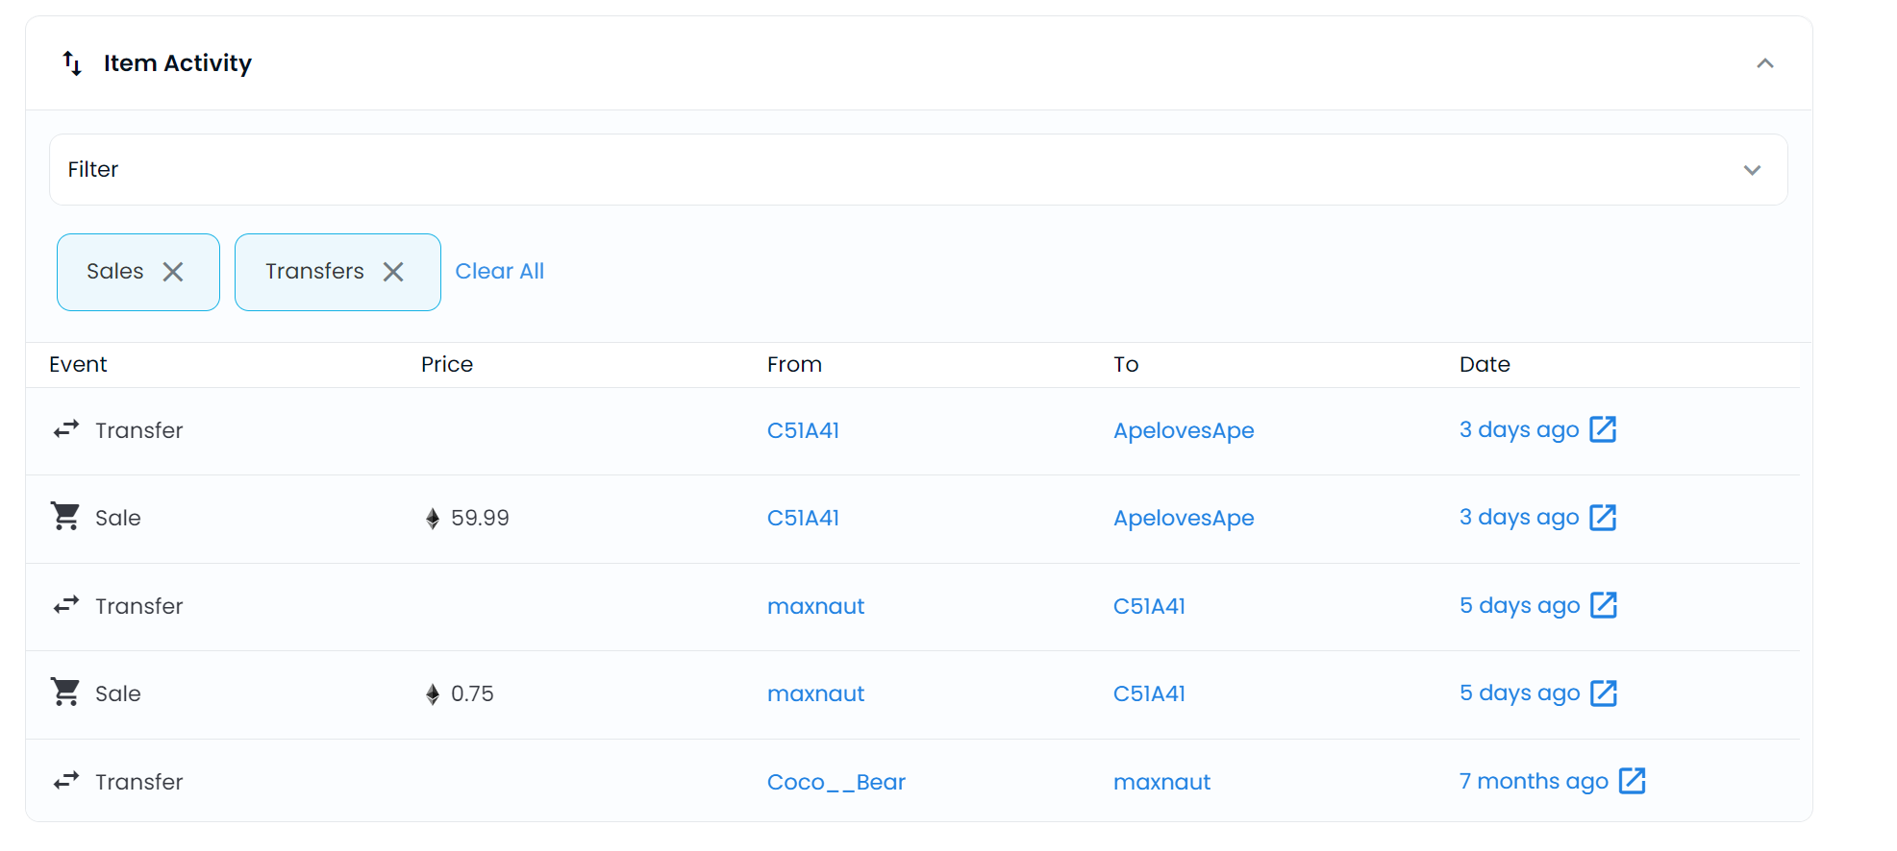
Opensea

Slide 12
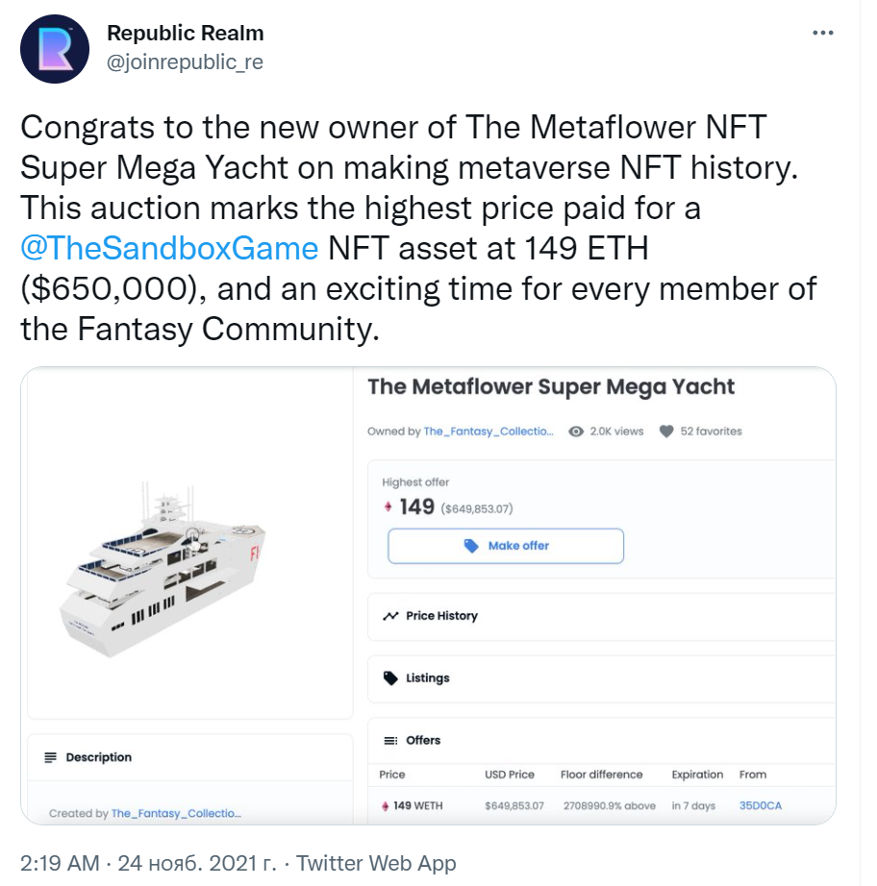
ART

Slide 13
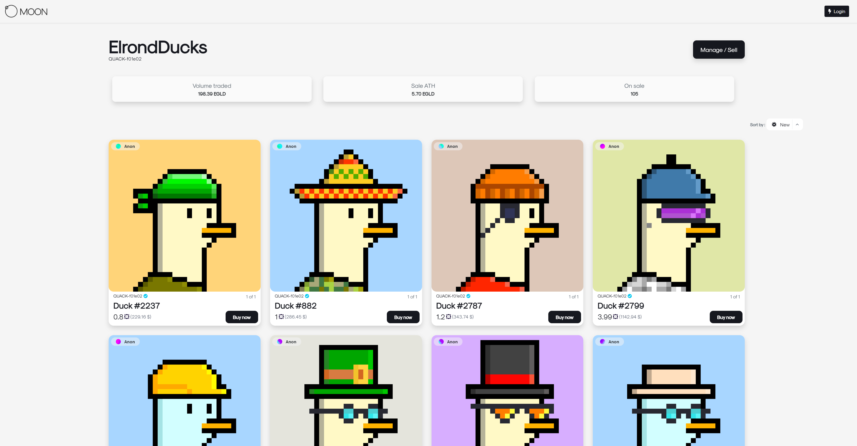
Competition

Slide 14
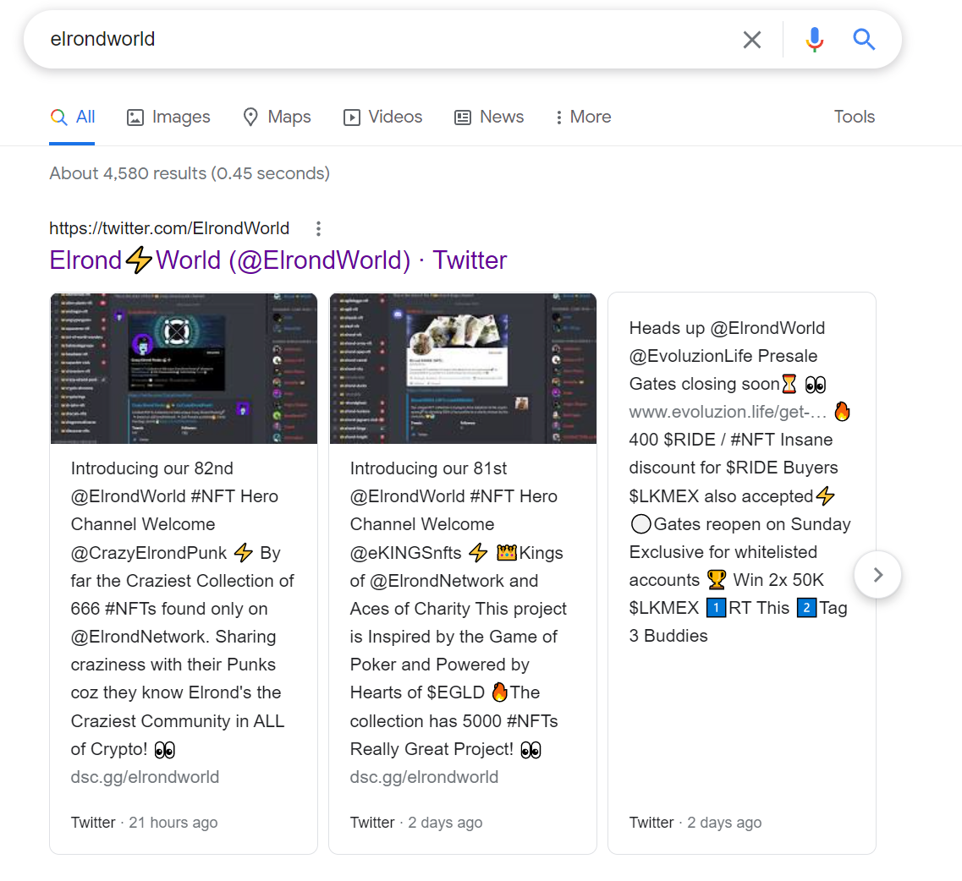
Elrondworld

Slide 15
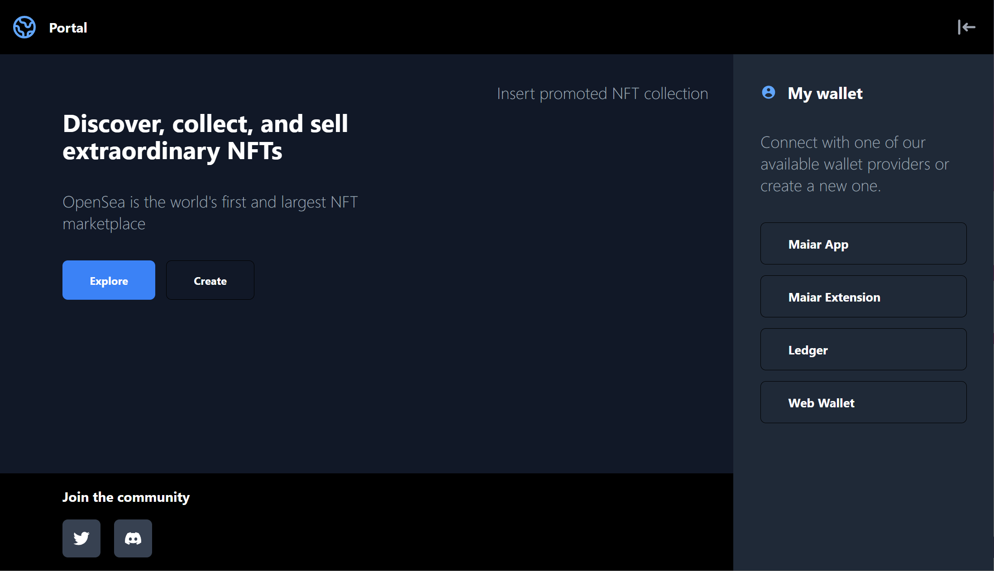
Prototype

Slide 16
TALLINN UNIVERSITY OF TECHNOLOGY
TALTECH.EE/EN

